Slide 1
Microservices
Chapter 5

Slide 2
Agenda
By the end of this chapter, you will learn about the following:
The Spring Config server for externalizing configuration
The Eureka server for service registration and discovery
The relevance of Zuul as a service proxy and gateway
The implementation of automatic microservice registration and service discovery
Spring Cloud messaging for asynchronous microservice composition

Slide 3
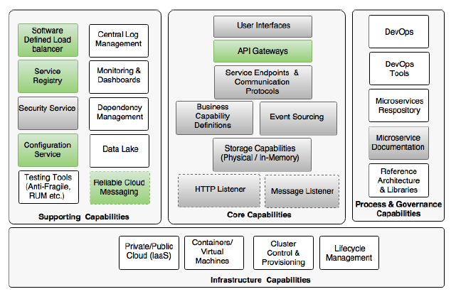
Microservice Capability Model
Notes:
• Software Defined Load Balancer
• Service Registry
• Configuration Service
• Reliable Cloud Messaging
• API Gateways

Slide 4
We already accomplished:
Each microservice exposes a set of REST/JSON endpoints for accessing business capabilities
Each microservice implements certain business functions using the Spring framework.
Each microservice stores its own persistent data using H2, an in-memory database
Microservices are built with Spring Boot, which has an embedded Tomcat server as the HTTP listener
RabbitMQ is used as an external messaging service. Search, Booking, and Check-in interact with each other through asynchronous messaging
Swagger is integrated with all microservices for documenting the REST APIs.
An OAuth2-based security mechanism is developed to protect the microservices

Slide 5
Spring Cloud
Implements a set of common patterns required by distributed systems, as a set of easy-to-use Java Spring libraries.
Spring Cloud also provides simple, easy-to-use Spring-friendly APIs, which abstract the cloud provider's service APIs such as those APIs coming with AWS Notification Service.
Spring Cloud defaults all configurations,
When not using Spring Cloud, developers will end up using services natively provided by the cloud vendors, resulting in deep coupling with the PaaS providers
Notes:
The cloud-ready solutions that are developed using Spring Cloud are also agnostic and portable across many cloud providers such as
Cloud Foundry, AWS, Heroku, and so on
For example: service registry can be implemented using popular options such as Eureka, ZooKeeper, or Consul.
The components of Spring Cloud are fairly decoupled, hence, developers get the flexibility to pick and choose what is required.
What is the difference between Spring Cloud and Cloud Foundry?
Spring Cloud is a developer kit for developing Internet-scale Spring Boot applications, whereas Cloud Foundry is an open-source Platform as a Service (PaaS) for building, deploying, and scaling applications.

Slide 6
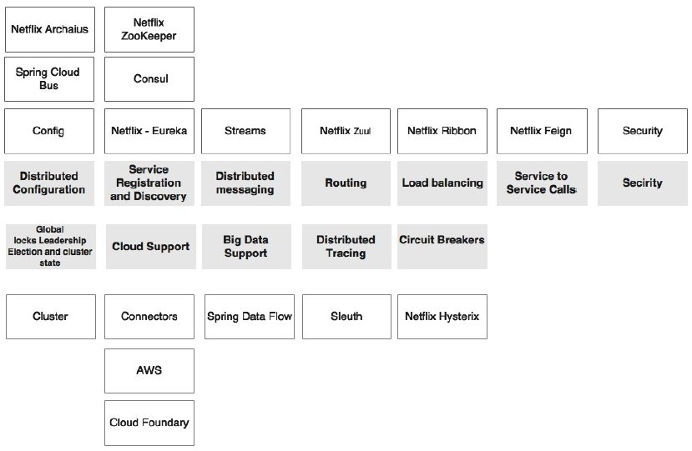
Components of Spring Cloud

Slide 7
Distributed configuration
Configuration properties are hard to manage when there are many microservice instances running under different profiles such as development, test, production, and so on.
The distributed configuration management module is to externalize and centralize microservice configuration parameters.
Spring Cloud Config is an externalized configuration server with Git or SVN as the backing repository.
Spring Cloud Bus provides support for propagating configuration changes to multiple subscribers, generally a microservice instance.
Alternately, ZooKeeper or HashiCorp's Consul can also be used for distributed configuration management.

Slide 8
Routing
Routing is an API gateway component, primarily used similar to a reverse proxy that forwards requests from consumers to service providers.
The gateway component can also perform software-based routing and filtering.
Zuul is a lightweight API gateway solution that offers fine-grained controls to developers for traffic shaping and request/ response transformations.

Slide 9
Load balancing
The load balancer capability requires a software-defined load balancer module which can route requests to available servers using a variety of load balancing algorithms.
Ribbon is a Spring Cloud subproject which supports this capability.
Ribbon can work as a standalone component, or integrate and work seamlessly with Zuul for traffic routing.

Slide 10
Service registration and discovery
The service registration and discovery module enables services to programmatically register with a repository when a service is available and ready to accept traffic.
How does it work?
The microservices advertise their existence, and make them discoverable.
The consumers can then look up the registry to get a view of the service availability and the endpoint locations.
The registry, in many cases, is more or less a dump. But the components around the registry make the ecosystem intelligent.
There are many subprojects existing under Spring Cloud which support registry and discovery capability.
Eureka, ZooKeeper, and Consul are three subprojects implementing the registry capability.

Slide 11
Service-to-service calls
The Spring Cloud Feign subproject under Spring Cloud offers a declarative approach for making RESTful service-to-service calls in a synchronous way.
The declarative approach allows applications to work with POJO (Plain Old Java Object) interfaces instead of low-level HTTP client APIs.
Feign internally uses reactive libraries for communication.

Slide 12
Circuit breaker
The circuit breaker subproject implements the circuit breaker pattern.
The circuit breaker breaks the circuit when it encounters failures in the primary service by diverting traffic to another temporary fallback service.
It also automatically reconnects back to the primary service when the service is back to normal.
It finally provides a monitoring dashboard for monitoring the service state changes.
The Spring Cloud Hystrix project and Hystrix Dashboard implement the circuit breaker and the dashboard respectively.

Slide 13
Global locks, leadership election and cluster state
This capability is required for cluster management and coordination when dealing with large deployments.
It also offers global locks for various purposes such as sequence generation.
The Spring Cloud Cluster project implements these capabilities using Redis, ZooKeeper, and Consul.

Slide 14
Security
Security capability is required for building security for cloud-native distributed systems using externalized authorization providers such as OAuth2.
The Spring Cloud Security project implements this capability using customizable authorization and resource servers.
It also offers SSO capabilities, which are essential when dealing with many microservices.

Slide 15
Big data support
The big data support capability is a capability that is required for data services and data flows in connection with big data solutions.
The Spring Cloud Streams and the Spring Cloud Data Flow projects implement these capabilities.
The Spring Cloud Data Flow is the re-engineered version of Spring XD.

Slide 16
Distributed tracing
The distributed tracing capability helps to thread and correlate transitions that are spanned across multiple microservice instances.
Spring Cloud Sleuth implements this by providing an abstraction on top of various distributed tracing mechanisms such as Zipkin and HTrace with the support of a 64-bit ID.

Slide 17
Distributed messaging
Spring Cloud Stream provides declarative messaging integration on top of reliable messaging solutions such as Kafka, Redis, and RabbitMQ

Slide 18
Cloud support
Spring Cloud also provides a set of capabilities that offers various connectors, integration mechanisms, and abstraction on top of different cloud providers such as the Cloud Foundry and AWS

Slide 19
History Behind Microservices
Many of the Spring Cloud components came from the Netflix Open Source Software (Netflix OSS) center
Netflix is one of the pioneers and early adaptors in the microservices space.
Netflix open-sourced their components, and made them available under the Netflix OSS platform for public use
Spring Cloud offers higher levels of abstraction for these Netflix OSS components, making it more Spring developer friendly
It also provides a declarative mechanism, well-integrated and aligned with Spring Boot and the Spring framework

Slide 20
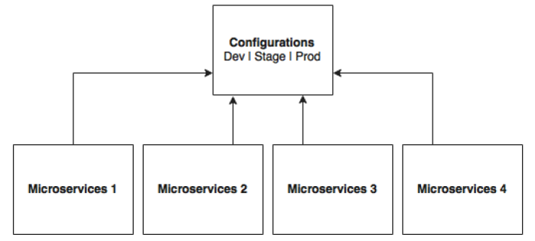
Configuration Properties
For large scale deployments, a simple yet powerful centralized configuration management solution is required
Notes:
The microservices locally cache parameters to improve performance.
The Config server propagates the configuration state changes to all subscribed microservices so that the local cache's state can be
updated with the latest changes.
The Config server also uses profiles to resolve values specific to an environment
Config Server, Zookeeper Configuration, and Consul Configuration are available as options for building configuration server.

Slide 21
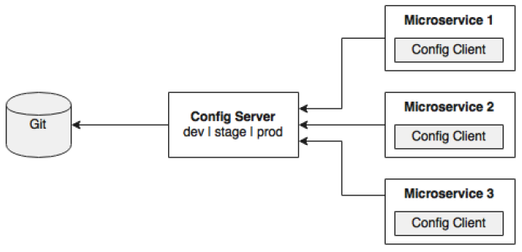
The Spring Config server stores properties in a version-controlled repository such as Git or SVN.
The Git repository can be local or remote.
A highly available remote Git server is preferred for large scale distributed microservice deployments.
Notes:
the Config client embedded in the Spring Boot microservices does a configuration lookup from a central configuration server using a simple declarative mechanism, and stores properties into the Spring environment.
The configuration properties can be application-level configurations such as trade limit per day, or infrastructure-related configurations such as server URLs, credentials, and so on.

Slide 22
Spring Cloud (Cont.)
Unlike Spring Boot, Spring Cloud uses a bootstrap context, which is a parent context of the main application
Bootstrap context is responsible for loading configuration properties from the Config server
The bootstrap context looks for bootstrap.yaml or bootstrap.properties for loading initial configuration properties.
To make this work in a Spring Boot application, rename the application.* file to bootstrap.*.

Slide 23
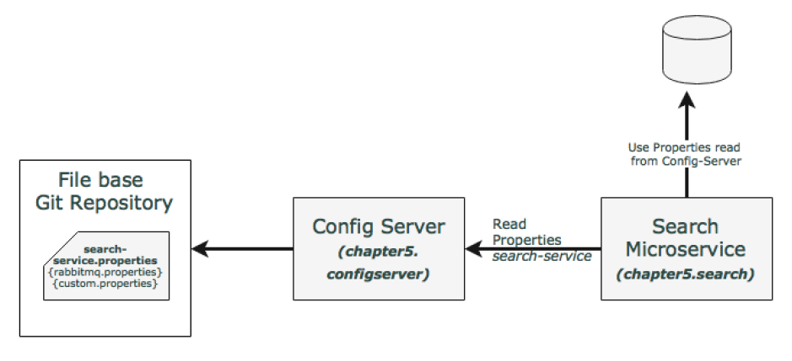
What’s Next?
Notes:
Check out chapter5.search

Slide 24
For manual implementation, check out pages [214-222] of the book
Notes:
The Config server will use the name to resolve and pick up appropriate properties from the Config server repository.
The application name is also sometimes referred to as service ID. If there is an application with the name myapp, then there should be a myapp.properties in the configuration repository to store all the properties related to that application.
The profile names are logical names that will be used for matching the file name in the repository. The default profile is named default. To configure properties for
different environments, we have to configure different files as given in the following example.
application-development.properties
application-production.properties
These are accessible using the following URLs respectively:
• http://localhost:8888/application/development
• http://localhost:8888/application/production

Slide 25
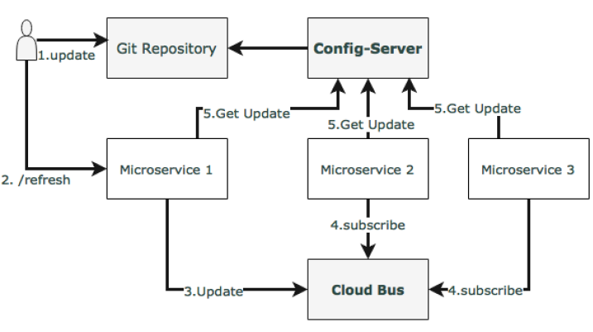
Spring Cloud Bus for propagating configuration changes
Notes:
In case of multiple services with several update requests, connect all service instances through a single message broker.
Each instance subscribes for change events, and refreshes its local configuration when required. This refresh is triggered by making a call to any one instance by hitting the
/bus/refresh endpoint, which then propagates the changes through the cloud bus and the common message broker.

Slide 26
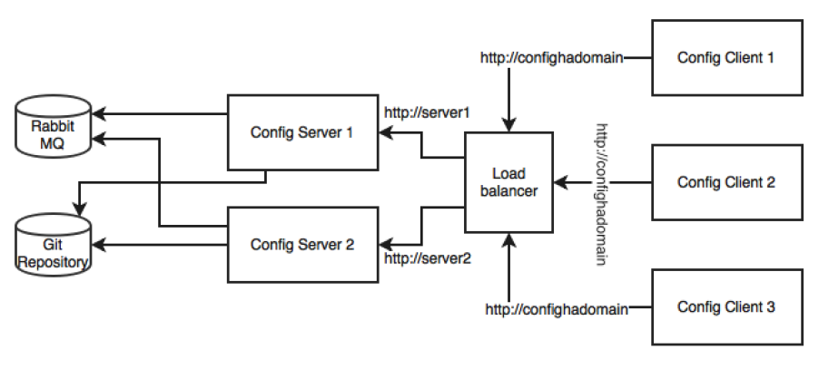
Setting up high availability for the Config server
Previously, Config server is a single point of failure in this architecture.
high availability architecture for the Config server, check this diagram:
Notes:
Actually, There are three single points of failure in the default architecture that was established in the previous section.
One of them is the availability of the Config server itself,
The second one is the Git repository,
and the third one is the RabbitMQ server.
For highly available Git:
https://about.gitlab.com/high-availability/.
For highly available RabbitMQ:
https://www.rabbitmq.com/ha.html.
These are not covered here because these are Git is required to be highly available only when the Config server needs to be scaled
Also, RabbitMQ has to be configured for high availability only to push configuration changes dynamically to all instances. Since this is more of an offline controlled activity, it does not really require the same high availability as required by the components.

Slide 27
Feign as a declarative REST client
Previously, When using RestTemplate, the URL parameter is constructed programmatically, and data is sent across to the other service
Feign is a Spring Cloud Netflix library for providing a higher level of abstraction over REST-based service calls
Notes:
Spring Cloud Feign works on a declarative principle. When using Feign, we write declarative REST service interfaces at the client, and use those interfaces to program the client.
The developer need not worry about the implementation of this interface. This will be dynamically provisioned by Spring at runtime. With this declarative approach, developers need not get into the details of the HTTP level APIs provided by RestTemplate.
It used to be:
Fare fare = restTemplate.getForObject(FareURL +"/get?flightNumber="+record.getFlightNumber()+"&flightDate="+record.getFlightDate(),Fare.class);
Using Feign as a new FareServiceProxy:
@FeignClient(name="fares-proxy", url="localhost:8080/fares")
public interface FareServiceProxy {
@RequestMapping(value = "/get", method=RequestMethod.GET)
Fare getFare(@RequestParam(value="flightNumber") String flightNumber, @RequestParam(value="flightDate") String flightDate);
}
And add @EnableFeignClients at the class level of BookingComponent
Also (see first line of this note, and replace it with this:
Fare = fareServiceProxy.getFare(record.getFlightNumber(), record.getFlightDate());

Slide 28
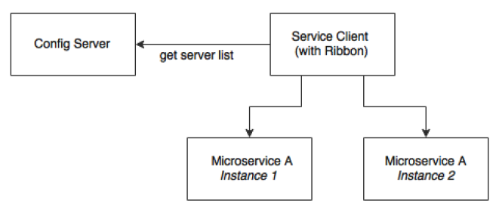
Ribbon for load balancing
Use a load balancer or a local DNS server to abstract the actual instance locations, and configure an alias name or the load balancer address in the clients
The load balancer then receives the alias name, and resolves it with one of the available instances.
Notes:
Update the Booking microservice configuration file, booking-service.properties, to include a new property to keep the list of the Fare microservices:
fares-proxy.ribbon.listOfServers=localhost:8080,localhost:8081
Now notice:
@FeignClient(name="fares-proxy")
@RibbonClient(name="fares")
public interface FareServiceProxy {
@RequestMapping(value = "fares/get", method=RequestMethod.GET)

Slide 29
Is Ribbon-based load balancing sufficient ?
If there is a large number of microservices, and if we want to optimize infrastructure utilization, we will have to dynamically change the number of service instances and the associated servers.
It is not easy to predict and preconfigure the server URLs in a configuration file.
When targeting cloud deployments for highly scalable microservices, static registration and discovery is not a good solution considering the elastic nature of the cloud environment.
In the cloud deployment scenarios, IP addresses are not predictable, and will be difficult to statically configure in a file. We will have to update the configuration file every time there is a change in address.
Notes:
With Ribbon, we can dynamically change the service instances, but whenever we add new service instances or shut down instances, we will have to manually update the Config server.
Though the configuration changes will be automatically propagated to all required instances, the manual configuration changes will not work with large scale deployments. When managing large deployments, automation, wherever possible, is paramount
To fix this gap, the microservices should self-manage their life cycle by dynamically registering service availability, and provision automated discovery for consumers.

Slide 30
Understanding dynamic service registration and discovery
Dynamic registration is from the service provider's point of view.
when a new service is started, it automatically enlists its availability in a central service registry
when a service goes out of service, it is automatically delisted from the service registry
The registry always keeps up-to-date information of the services available, as well as their metadata

Slide 31
Understanding dynamic service registration and discovery (Cont.)
Dynamic discovery is applicable from the service consumer's point of view
Dynamic discovery is where clients look for the service registry to get the current state of the services topology, and then invoke the services accordingly
In this approach, instead of statically configuring the service URLs, the URLs are picked up from the service registry
The clients may keep a local cache of the registry data for faster access
State changes in the registry server will be propagated to the interested parties to avoid using stale data.
For dynamic service registration and discovery. Netflix Eureka, ZooKeeper, and Consul are available as part of Spring Cloud.
Notes:
Etcd is another service registry available outside of Spring Cloud to achieve dynamic service registration and discovery

Slide 32
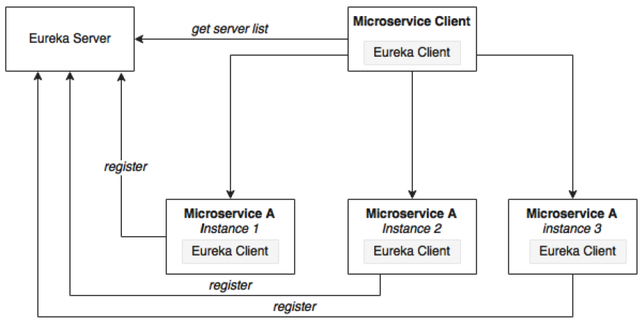
Understanding Eureka
Eureka is primarily used for self-registration, dynamic discovery, and load balancing.
Eureka uses Ribbon for
load balancing internally
Notes:
Eureka consists of a server component and a client-side component.
The server component is the registry in which all microservices register their availability The registration typically includes service identity and its URLs.
The microservices use the Eureka client for registering their availability. The consuming components will also use the Eureka client for discovering the service instances.
What actually happens:
When a microservice is bootstrapped, it reaches out to the Eureka server, and advertises its existence with the binding information.
Once registered, the service endpoint sends ping requests to the registry every 30 seconds to renew its lease
The registry information will be replicated to all Eureka clients so that the clients have to go to the remote Eureka server for each and every request.
Eureka clients fetch the registry information from the server, and cache it locally.
After that, the clients use that information to find other services.
When a client wants to contact a microservice endpoint, the Eureka client provides a list of currently available services based on the requested service ID.
The Eureka server is zone aware. Zone information can also be supplied when registering a service.
When a client requests for a services instance, the Eureka service tries to find the service running in the same zone.
The Ribbon client then load balances across these available service instances supplied by the Eureka client.
The communication between the Eureka client and the server is done using REST and JSON.

Slide 33
Understanding Eureka
the Eureka server itself is another Eureka client.
The client component is responsible for synchronizing state from the other Eureka servers.
The Eureka client is taken to its peers by configuring the eureka.client. serviceUrl.defaultZone property.
The following property has to be added to all microservices in their respective configuration files under config-repo. This will help the microservices to connect to the Eureka server.
Commit to Git once updates are completed:
eureka.client.serviceUrl.defaultZone: http://localhost:8761/eureka/
Notes:
We will remove our earlier Ribbon client, and use Eureka instead.
Eureka internally uses Ribbon for load balancing. Hence, the load balancing behavior will not change.

Slide 34
For step-by-step Eureka implementation, check book pages [235-241]

Slide 35
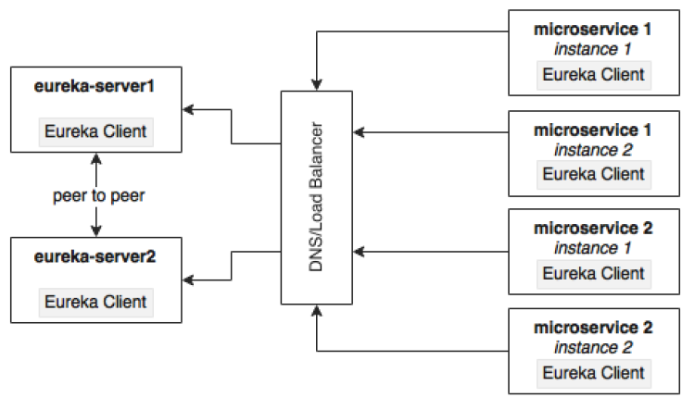
High Available Eureka
Notes:
The Eureka server is built with a peer-to-peer data synchronization mechanism. The runtime state information is not stored in a database, but managed using an in-memory cache. The high availability implementation favors availability and partition tolerance in the CAP theorem, leaving out consistency
CAP: Consistency. Availability. Partition tolerance
The peer-to-peer synchronization is done by pointing serviceUrls to each other. If there is more than one Eureka server, each one has to be connected to at least one of the peer servers. Since the state is replicated across all peers, Eureka clients can connect to any one of the available Eureka servers.
The best way to achieve high availability for Eureka is to cluster multiple Eureka servers, and run them behind a load balancer or a local DNS. The clients always connect to the server using the DNS/load balancer. At runtime, the load balancer takes care of selecting the appropriate servers. This load balancer address will be provided to the Eureka clients.

Slide 36
To run two Eureka servers in a cluster for high availability, check pages [242-243]

Slide 37
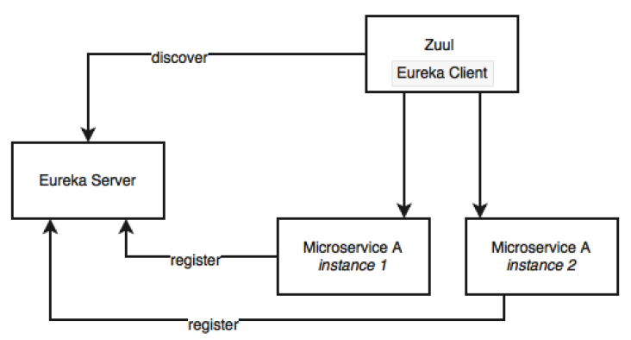
Zuul proxy as the API gateway

Slide 38
Zuul proxy as the API gateway
Internal microservice endpoints are not exposed outside, though, other set of public services will be exposed to the clients using an API gateway. WHY ?
Only a selected set of microservices are required by the clients.
If there are client-specific policies to be applied, it is easy to apply them in a single place rather than in multiple places. An example of such a scenario is the cross-origin access policy.
It is hard to implement client-specific transformations at the service endpoint.
If there is data aggregation required, especially to avoid multiple client calls in a bandwidth-restricted environment, then a gateway is required in the middle.

Slide 39
Zuul proxy as the API gateway
The Zuul proxy internally uses the Eureka server for service discovery, and Ribbon for load balancing between service instances.
The Zuul proxy is also capable of routing, monitoring, managing resiliency, security, and so on.
We can consider Zuul a reverse proxy service.
With Zuul, we can even change the behaviors of the underlying services by overriding them at the API layer.
For zuul setup and configuration, check pages at [245-247]

Slide 40
Zuul … useful ?
Enforcing authentication, security policies, token handling, blocking requests coming from certain black-listed users and so on before passing the request to the relevant services behind.
Business insights and monitoring can be implemented at the gateway level.
Collect real-time statistical data, and push it to an external system for analysis. This will be handy as we can do this at one place rather than applying it across many microservices.
When dynamic routing is required based on fine-grained controls.
For example, send requests to different service instances based on business specific values such as "origin country".
Another example is all requests coming from a region to be sent to one group of service instances.
Yet another example is all requests requesting for a particular product have to be routed to a group of service instances.
Handling the load shredding and throttling requirements.
This is when we have to control load based on set thresholds such as number of requests in a day.
For example, control requests coming from a low-value third party online channel.
Fine-grained load balancing scenarios. Developer has full control over the load balancing.
When data aggregation requirements are in place.
If the consumer wants higher level coarse-grained services, then the gateway can internally aggregate data by calling more than one service on behalf of the client. This is particularly applicable when the clients are working in low bandwidth environments.

Slide 41
Zuul Filters
Zuul also provides a number of filters.
These filters are classified as pre filters, routing filters, post filters, and error filters.
As the names indicate, these are applied at different stages of the life cycle of a service call.
Zuul also provides an option for developers to write custom filters
Check pages 248 for more information

Slide 42
High availability of Zuul
Zuul is just a stateless service with an HTTP endpoint, hence, we can have as many Zuul instances as we need
The availability of Zuul is extremely critical as all traffic from the consumer to the provider flows through the Zuul proxy
However, the elastic scaling requirements are not as critical as the backend microservices where all the heavy lifting happens

Slide 43
High availability of Zuul
When to make it Highly available?
When a client-side JavaScript MVC such as AngularJS accesses Zuul services from a remote browser.
Another microservice or non-microservice accesses services via Zuul
In some cases, the client may not have the capabilities to use the Eureka client libraries
for example, a legacy application written on PL/SQL. In some cases
organization policies do not allow Internet clients to handle client-side load balancing.
In the case of browser-based clients, there are third-party Eureka JavaScript libraries available. It all boils down to whether the client is using Eureka client libraries or not.

Slide 44
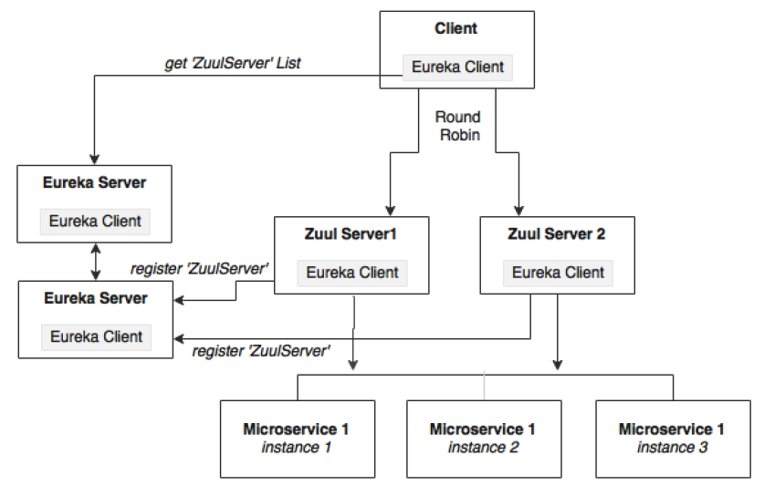
High availability of Zuul when the client is also a Eureka client
Notes:
In this case, since the client is also another Eureka client, Zuul can be configured just like other microservices. Zuul registers itself to Eureka with a service ID. The clients
then use Eureka and the service ID to resolve Zuul instances.
Zuul services register themselves with Eureka with a service ID, search-apigateway in our case. The Eureka client asks for the server list with the ID search-apigateway. The Eureka server returns the list of servers based on the current Zuul topology. The Eureka client, based on this list picks up one of the servers, and initiates the call.
In this case:
Flight[] flights = searchClient.postForObject("http://searchapigateway/api/search/get", searchQuery, Flight[].class);

Slide 45
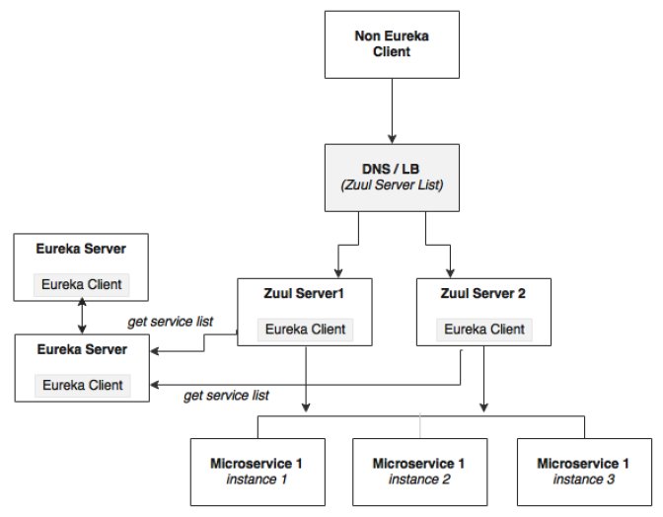
High availability when the client is not a Eureka client
Notes:
In this case, the client is not capable of handling load balancing by using the Eureka server.
As shown in the diagram, the client sends the request to a load balancer, which in turn identifies the right Zuul service instance. The Zuul instance, in this case, will be running behind a load balancer such as HAProxy or a hardware load balancer like NetScaler
he microservices will still be load balanced by Zuul using the Eureka server.

Slide 46
Completing Zuul for all other services
Add API gateway projects (name them as *-apigateway) for all our microservices.
The following steps are required to achieve this task:
Create new property files per service, and check in to the Git repositories.
Change application.properties to bootstrap.properties, and add the required configurations.
Add @EnableZuulProxy to Application.java in each of the *-apigateway projects.
Add @EnableDiscoveryClient in all the Application.java files under each of the *-apigateway projects.
Optionally, change the package names and file names generated by default.
In the end, we will have the following API gateway projects:
chapter5.fares-apigateway
chapter5.search-apigateway
chapter5.checkin-apigateway
chapter5.book-apigateway

Slide 47
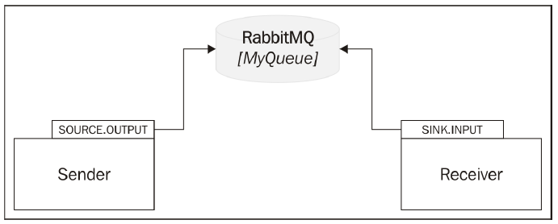
Streams for reactive microservices
Spring Cloud Stream provides an abstraction over the messaging infrastructure.
The underlying messaging implementation can be RabbitMQ, Redis, or Kafka.
Spring Cloud Stream provides a declarative approach for sending and receiving messages
Notes:
Cloud Stream works on the concept of a source and a sink
The source represents the sender perspective of the messaging, and sink represents the receiver perspective of the messaging
the sender defines a logical queue called Source.OUTPUT to which the sender sends messages
The receiver defines a logica queue called Sink.INPUT from which the receiver retrieves messages
The physical binding of OUTPUT to INPUT is managed through the configuration.
In this case, both link to the same physical queue—MyQueue on RabbitMQ. So, while at one end, Source.OUTPUT points to MyQueue, on the other end, Sink.INPUT points to the same MyQueue.
Spring Cloud offers the flexibility to use multiple messaging providers in one application such as connecting an input stream from Kafka to a Redis output stream, without managing the complexities
Spring Cloud Stream is the basis for message-based integration.
The Cloud Stream Modules subproject is another Spring Cloud library that provides many endpoint implementations.

Slide 48
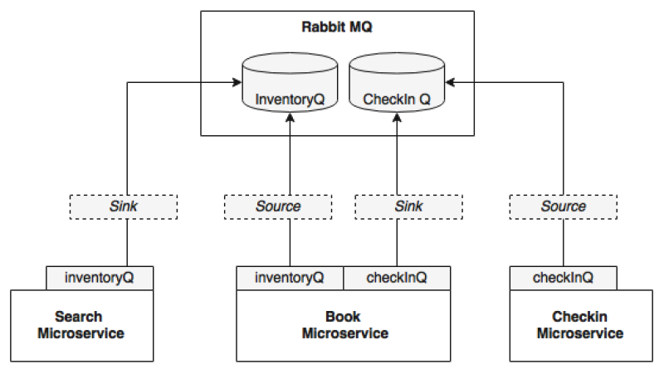
Back to PSS …
Notes:
we will define a SearchSink connected to InventoryQ under the Search microservice.
Booking will define a BookingSource for sending inventory change messages connected to InventoryQ.
Similarly, Check-in defines a CheckinSource for sending the check-in messages.
Booking defines a sink, BookingSink, for receiving messages, both bound to the CheckinQ queue on the RabbitMQ

Slide 49
Back to PSS…
Check pages [253-256]
Notes:
Add the following two properties to booking-service.properties.
These properties bind the logical queue inventoryQ to physical inventoryQ, and the logical checkinQ to the physical checkinQ:
spring.cloud.stream.bindings.inventoryQ.destination=inventoryQ
spring.cloud.stream.bindings.checkInQ.destination=checkInQ

Slide 50
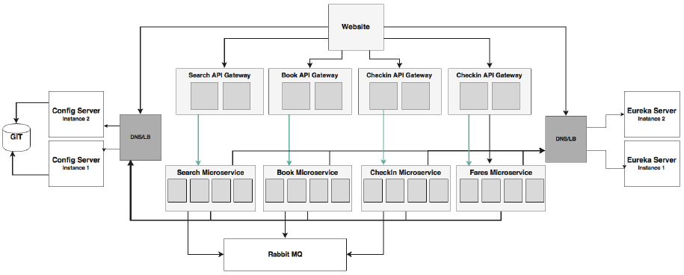
Summarizing the BrownField PSS architecture
The architecture includes the high availability of all components.
we assume that the client uses the Eureka client libraries

Slide 51
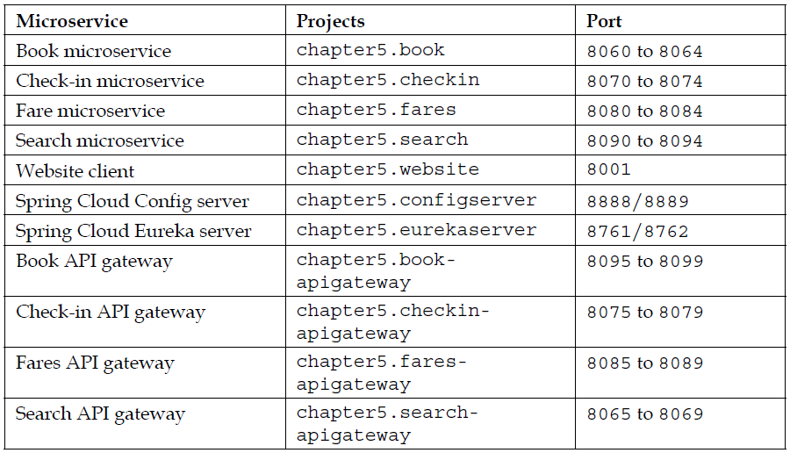
Summary of the projects and the ports

Slide 52
To run the project, follow the steps mentioned in pages [257-258]

